Slide 1

NYC Motor Vehicle Accident Data Analysis
Team 1: Tham Cao, Amit Patil, Georgia Smith, Abigail Butler
Notes:
Tham,

Slide 2
Data Description
Each row in our dataset has information about
Crash date/time - Interval
Location - Interval
Number of injuries/deaths - Ratio
Types of people (pedestrians/motorists/cyclists) injured/killed - Nominal
Types of vehicles involved - Nominal
Causes behind the accident – Nominal
Our dataset does not include accidents...
Resulting in 0 deaths and/or injuries
Not resulting in at least $1000 worth of damages
Notes:
Tham

Slide 3
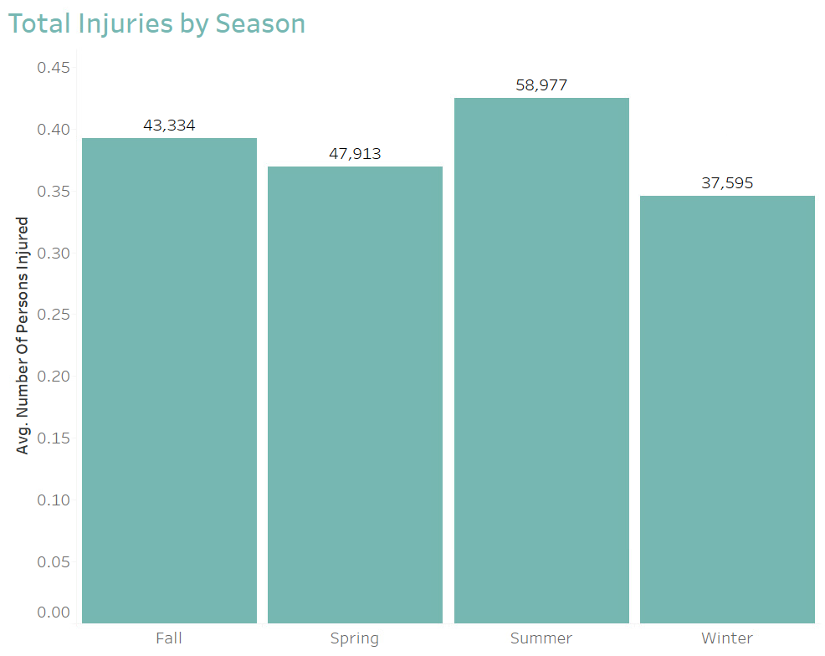
Injuries by Season
Summer has the highest average injuries per accident, at 0.42
Winter has the lowest average injuries per accident, at 0.35

Slide 4
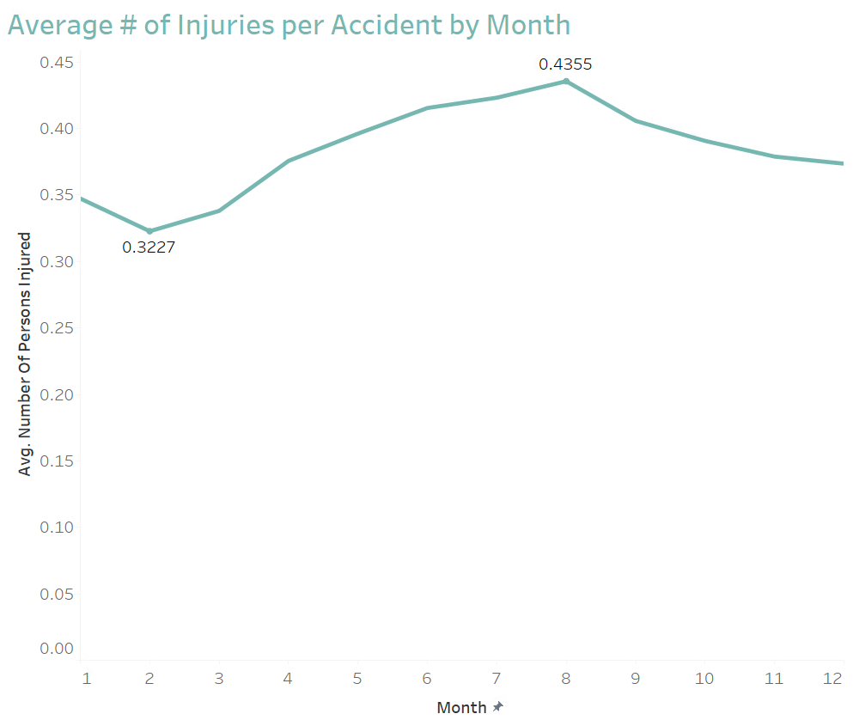
Injuries by Month
February has the lowest number at 0.32 per accident
August has the highest number at 0.44 per accident
Notes:
July is right behind at 0.42 and has the maximum number of injuries for one accident at 40

Slide 5
Contributing Factors
Driver Inattention / Distraction was the leading cause for the most accidents and resulted in the most injuries
Unsafe Speed Change resulted in the most deaths
Failure to Yield was within the top 3 occurrences & the 2nd top cause of injuries
Notes:
Tham:

Slide 6
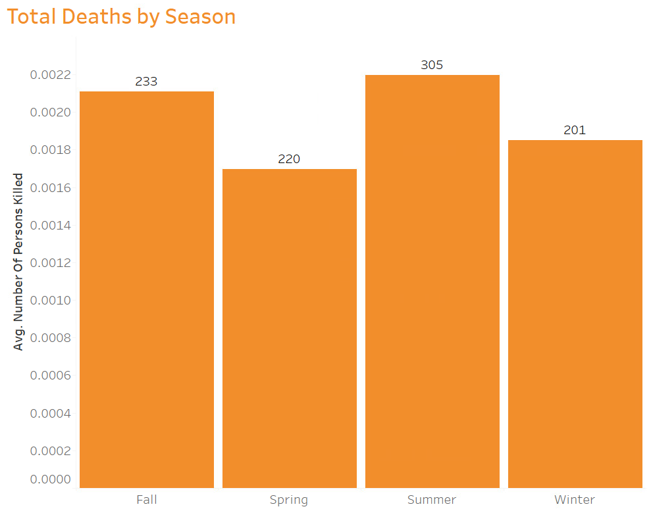
Deaths by Season
Summer has the highest average deaths per accident, at 0.0022
Spring has the lowest average deaths per accident, at 0.0017

Slide 7
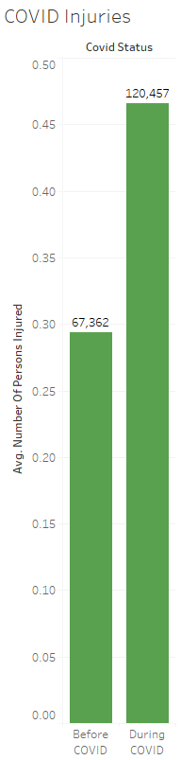
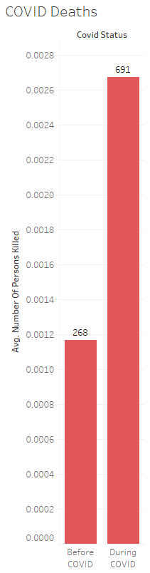
COVID-19
Injuries increased by over one and a half (1.8) during the pandemic, whereas deaths more than doubled (2.6)
Notes:
Georgia

Slide 8
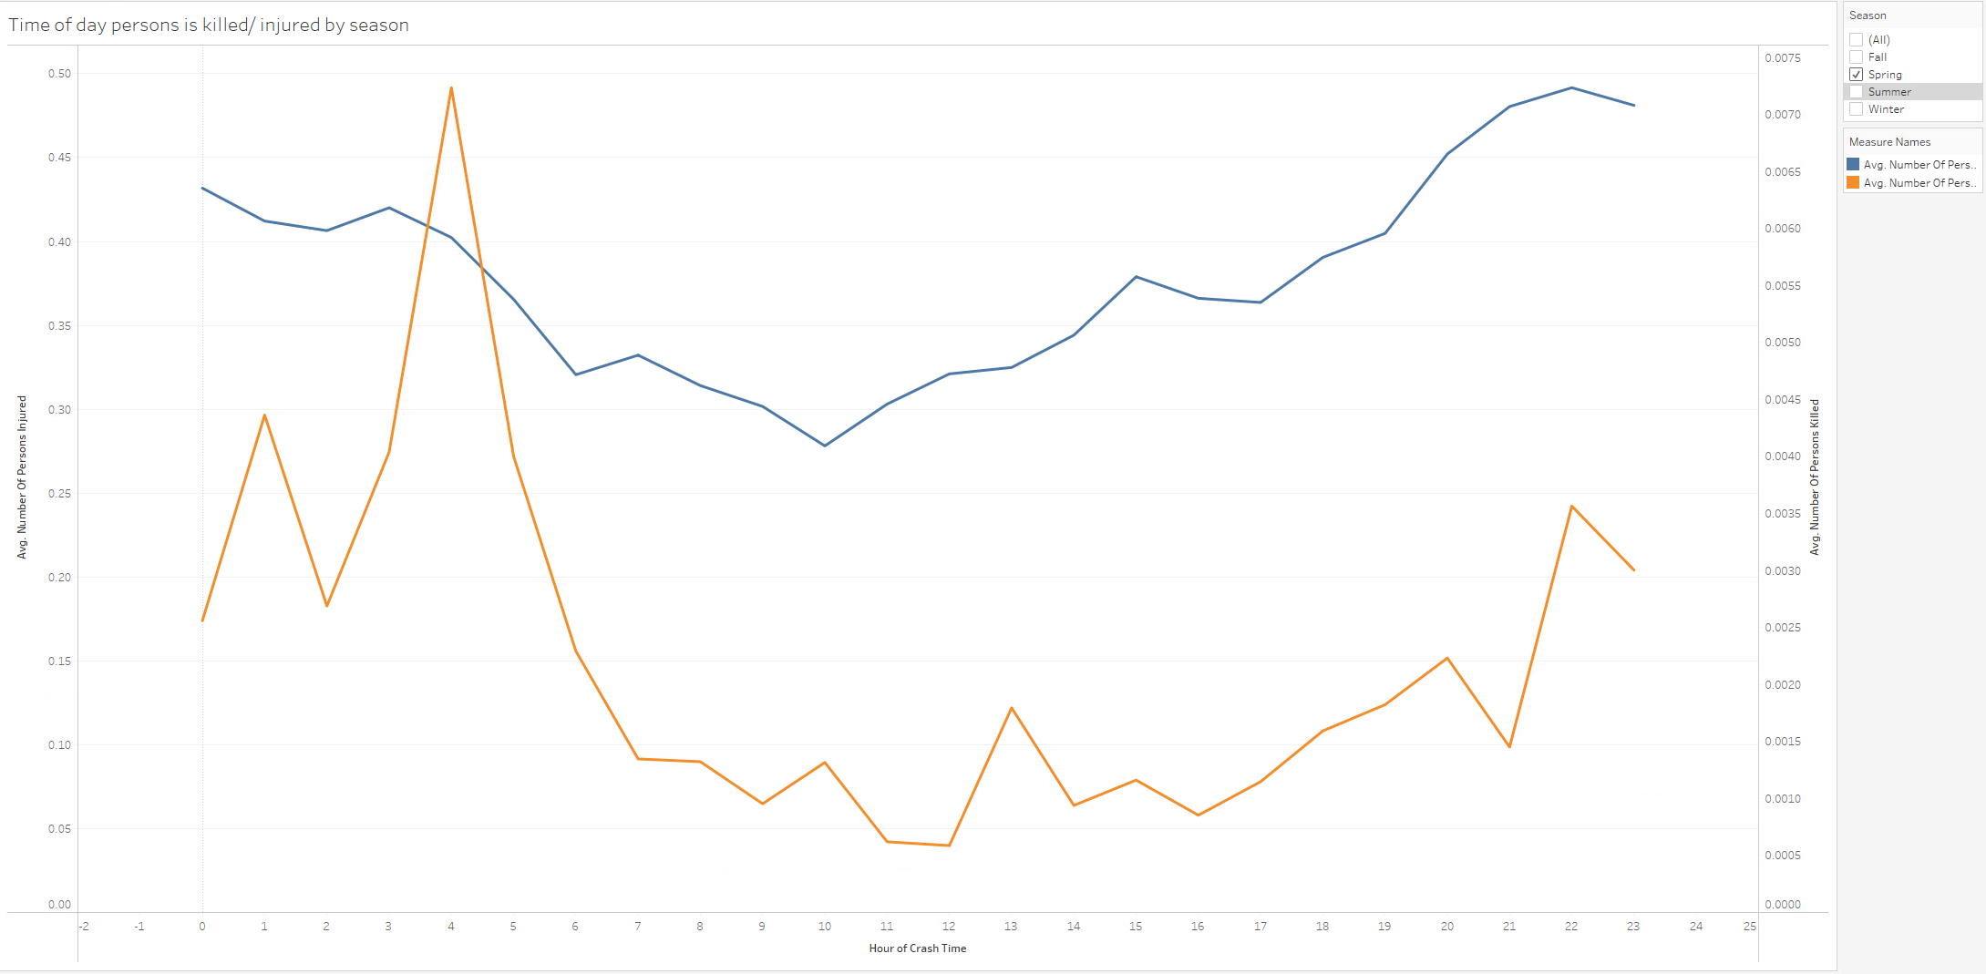
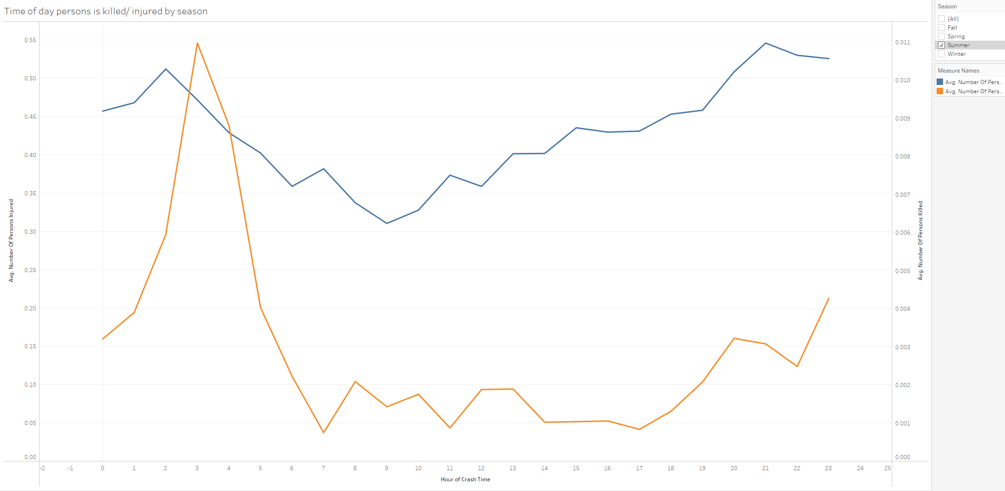
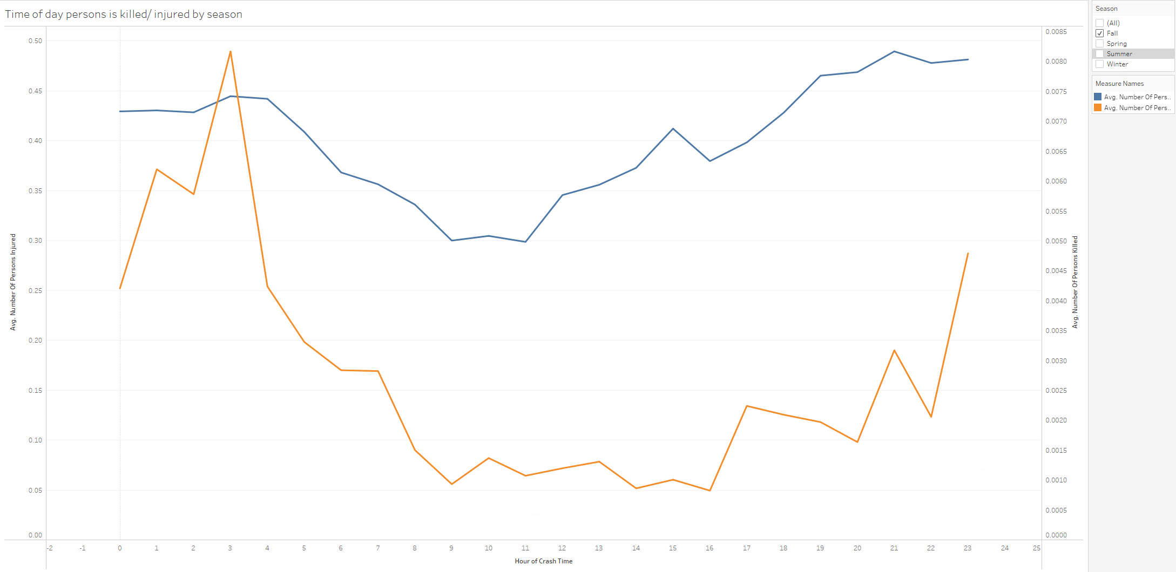
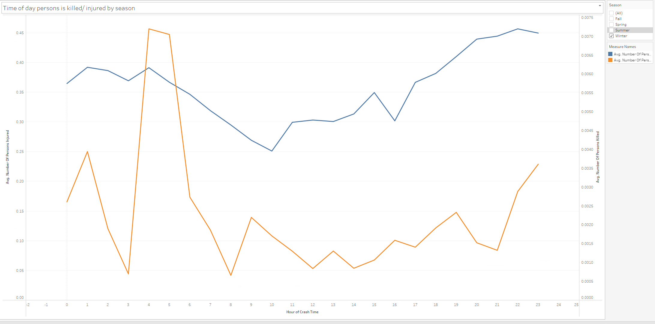

Time of Day
Time of Day Person is Killed/Injured by Seasons
Average deaths spike at 3-5 AM
Average injuries sharply decreases around 6 AM and slowly increases until 9-10 PM
SPRING
SUMMER
FALL
WINTER

Slide 9
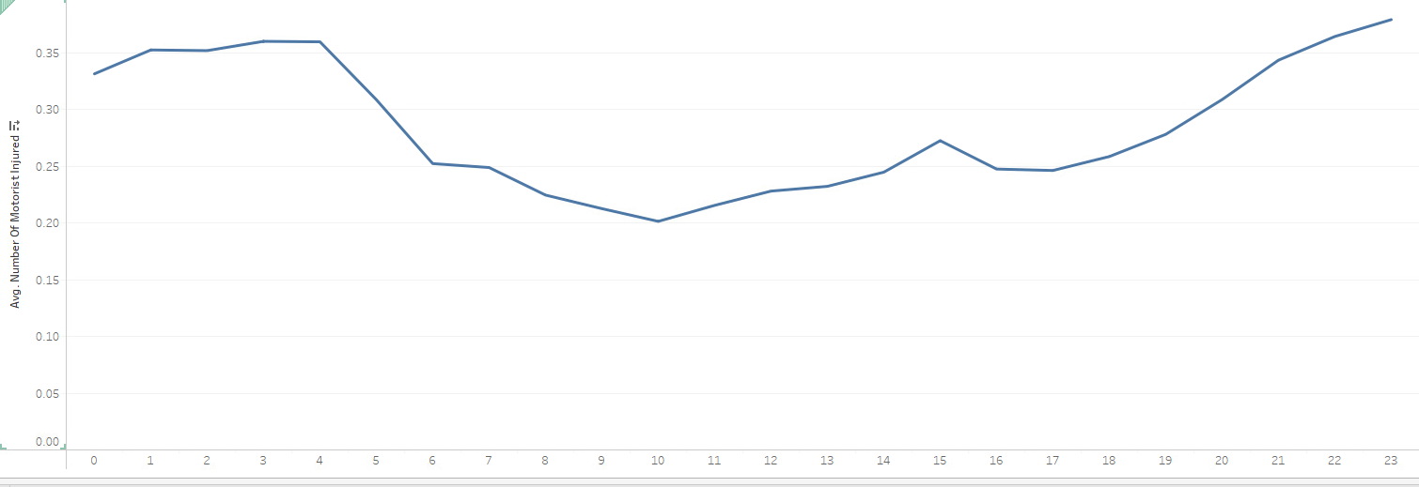
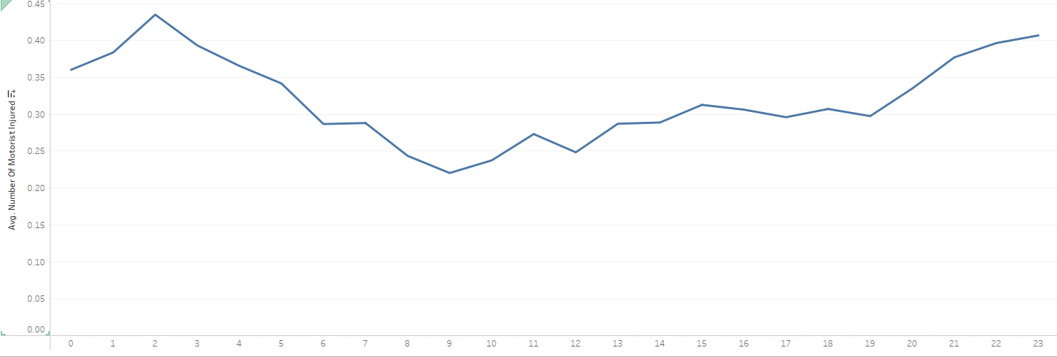
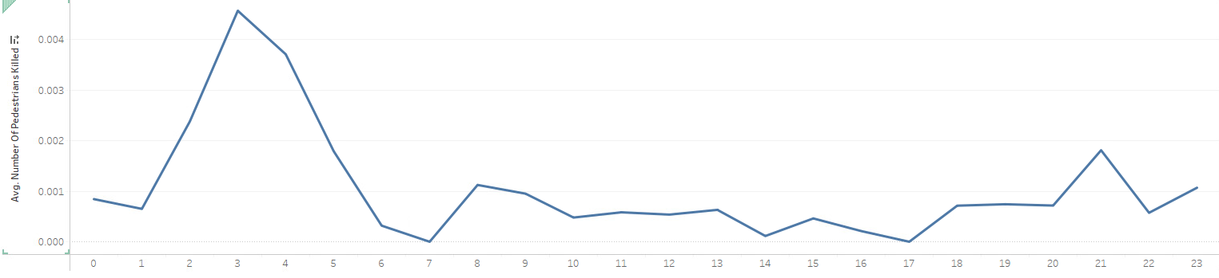
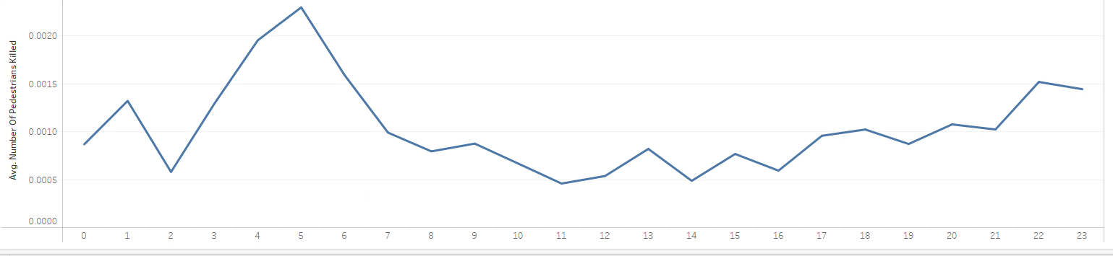
Time of Day by Season
OTHER SEASONS
Motorcyclist injuries spike in the summer, but specifically at 2 AM
The number of pedestrians killed on average is the lowest in the summer, specifically within 7 AM to 5 PM
SUMMER
SUMMER
OTHER SEASONS

Slide 10
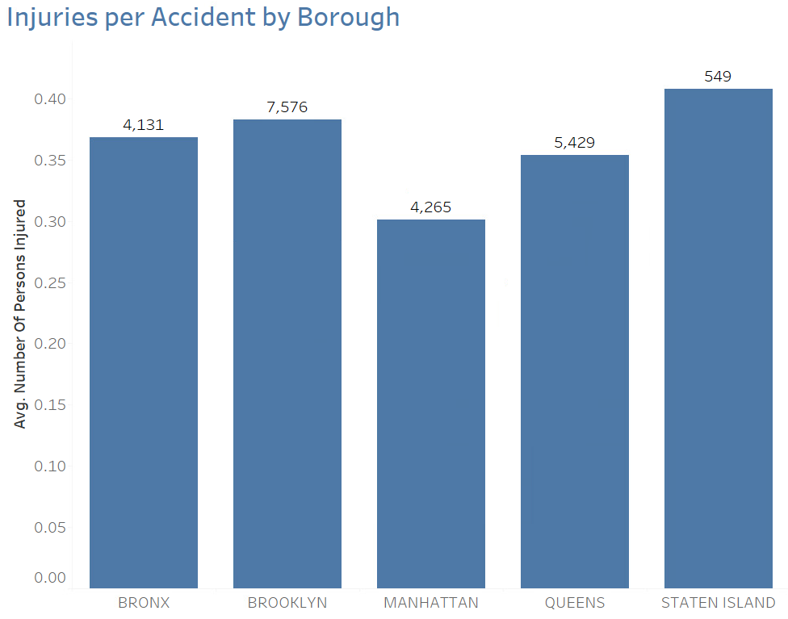
Borough
Staten Island has the highest injuries, at 0.41 per accident.
Manhattan has the lowest injuries, at 0.30 per accident.
Notes:
Amit:

Slide 11
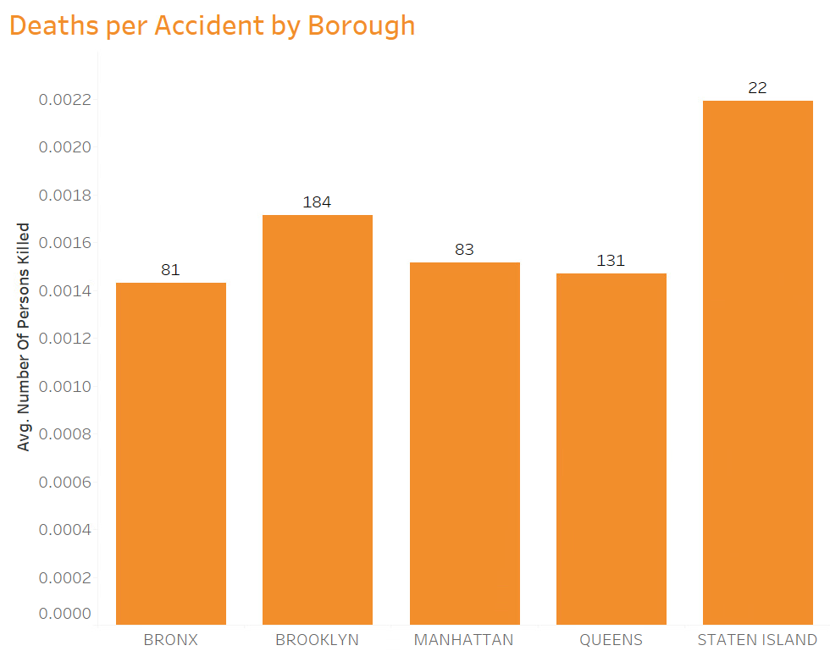
Borough
Staten Island has the highest deaths, at 0.0022 per accident.
Bronx has the lowest deaths, at 0.0014 per accident.
Notes:
Amit:

Slide 12
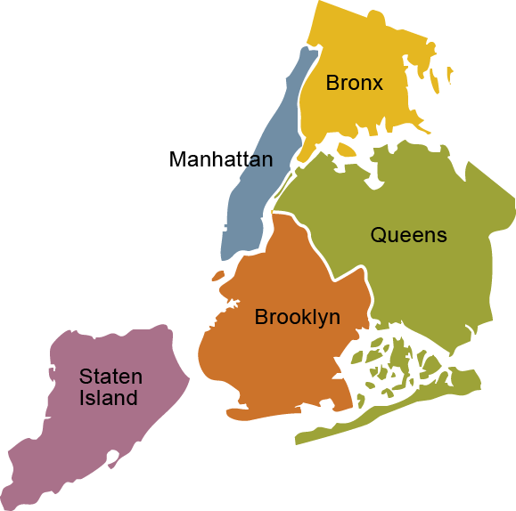
Total Accidents by Borough
55,696
54,778
89,219
107,320
10,039
Notes:
Amit:

Slide 13
Suggestions to NYP DOT & NYPD
Investigate the reasoning behind Manhattan's low numbers to try to replicate
Increase emphasis on driver attention and awareness to promote more vehicular safety.
Increase police patrols during 3 to 5 am where a spike in deaths occur as well as in high injury boroughs (e.g.. Staten Island & Brooklyn)
Place targeted and timed advertisement in boroughs with high accident numbers and make motorcyclist the highlight in ads as well as "share the roads" signs
1
2
3
4
Notes:
amit
Tham
Georgia
Abigail

Slide 14

Any questions?

